Slide 1
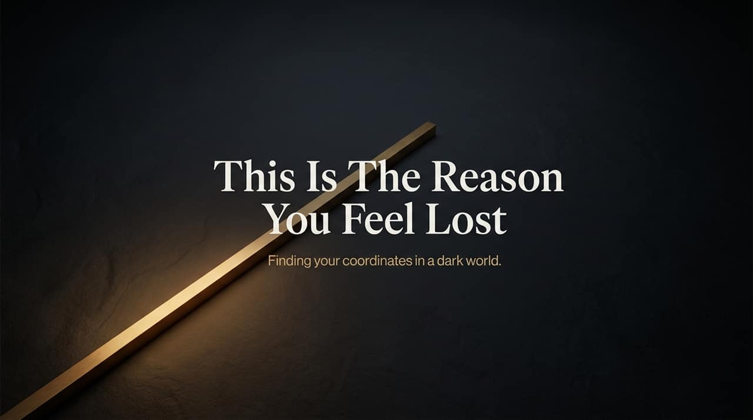
Notes:
Opening Hook: Welcome everyone. In today's culture, so many people walk around with a persistent sense of aimlessness and disorientation—like being stranded in complete darkness without a map or compass.
Core Message: The title of today’s presentation cuts straight to the point: “This Is The Reason You Feel Lost.” We aren't just here to diagnose the darkness, but to find our true coordinates.
Key Theme: True direction in life does not come from self-help strategies, cultural trends, or trusting our limited human reasoning. It comes from aligning our lives with the absolute truth of God's Word and stepping into the role of a Kingdom influencer. Over the next 16 slides, we will unpack how to shift from feeling lost to walking with divine purpose.
https://www.youtube.com/watch?v=P8e68Hbd8hU

Slide 2
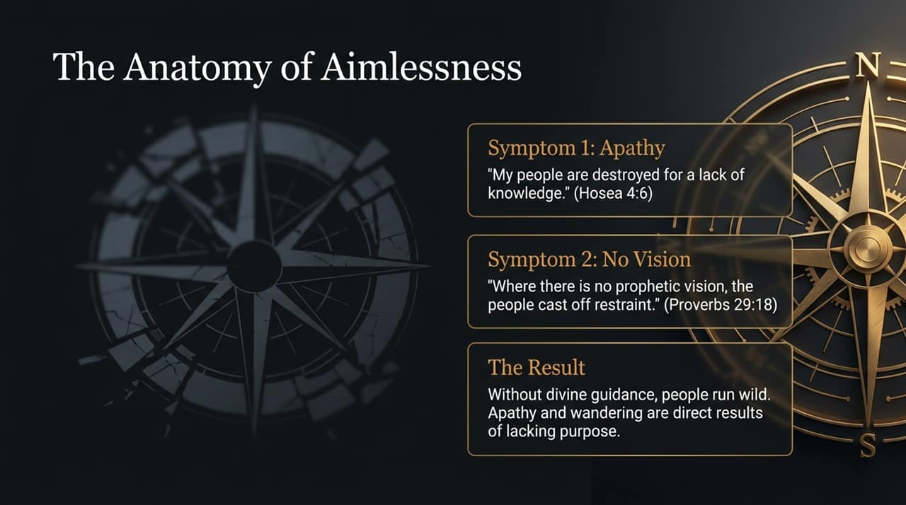
Notes:
Explanation: What does aimlessness actually look like in a person's life? It presents with two main spiritual symptoms:
Apathy & Ignorance: Hosea 4:6 tells us, "My people are destroyed for a lack of knowledge." When we disconnect from God's Word, we don't just stall—we are actively being destroyed. Apathy sets in because people don't know who God is or who they are in Him.
Lack of Vision: Proverbs 29:18 states, "Where there is no prophetic vision, the people cast off restraint." Without divine revelation, people become lazy, scattered, and lose discipline.
The Result: As the New Living Translation puts it, when people reject divine guidance, they run wild. Aimlessness isn't an accident; it is the direct outcome of living without a God-given target.

Slide 3
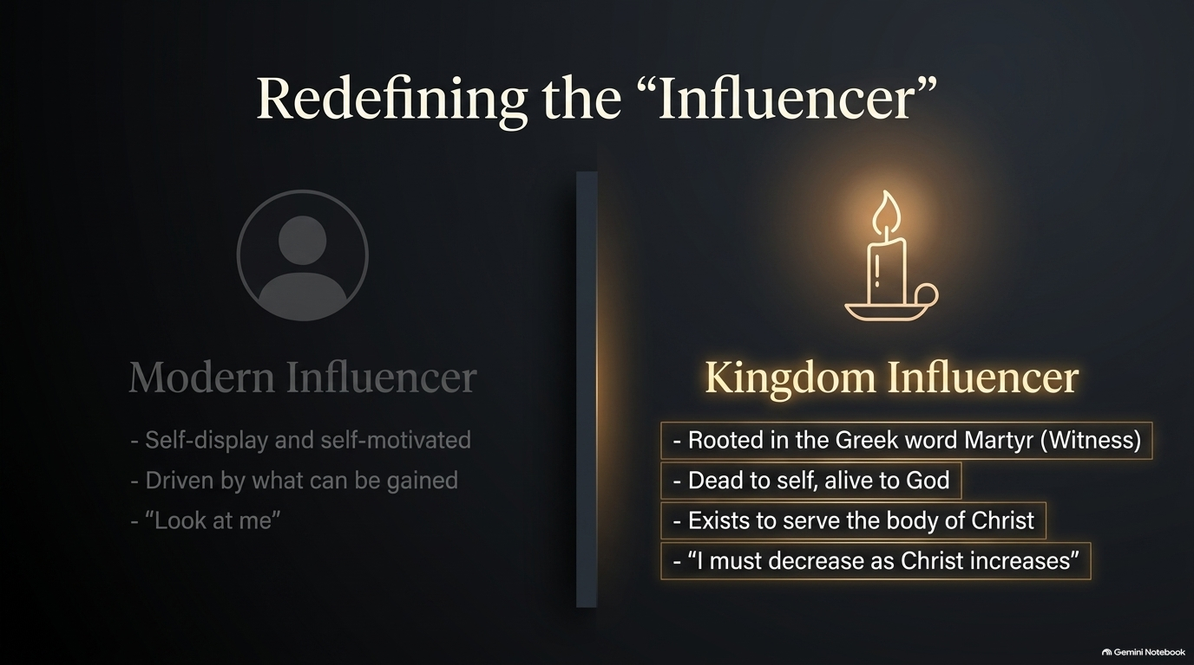
Notes:
Contrast: Society is obsessed with the word "influencer," but culture defines it through self-promotion and personal branding—a constant broadcast of "look at me" driven by self-gain.
Kingdom Definition: In the Kingdom of God, an influencer is built on an entirely different foundation. The original biblical Greek root for a witness/influencer is Martyr.
Application: Being a witness means being "dead to self" and "alive to God." As John the Baptist declared, "I must decrease as Christ increases." A Kingdom influencer doesn't ask, "What can I get out of the church or God?" Instead, they ask, "How can I serve the body of Christ and shine as a light in a dark world?"

Slide 4
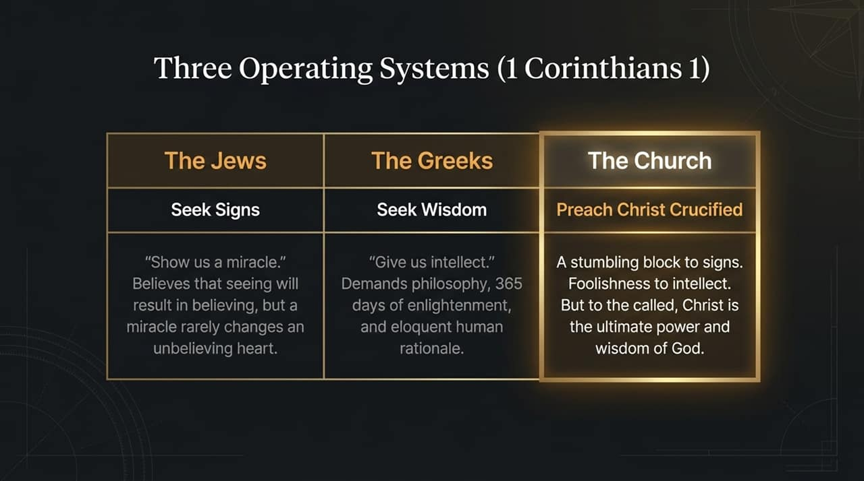
Notes:
Framework: In 1 Corinthians chapter 1, the Apostle Paul outlines three primary "operating systems" or mindsets by which people try to navigate life:
The Jews (Sign Seekers): They demanded miracles: "Show us a sign." Yet, even when Jesus performed miracles in front of them, their hearts remained in unbelief. Miracles alone rarely transform an unbelieving heart.
The Greeks (Wisdom Seekers): They demanded philosophy, human logic, and eloquence. To intellect-driven worldviews, the Gospel seems like complete foolishness.
The Church (The Called): We preach Christ crucified. While the cross is a stumbling block to sign-seekers and foolishness to intellectuals, to those who are called, Christ is the ultimate power and wisdom of God.
Takeaway: Do not look for worldly philosophies or demand flashy signs. True direction is anchored solely in the power of the cross.

Slide 5
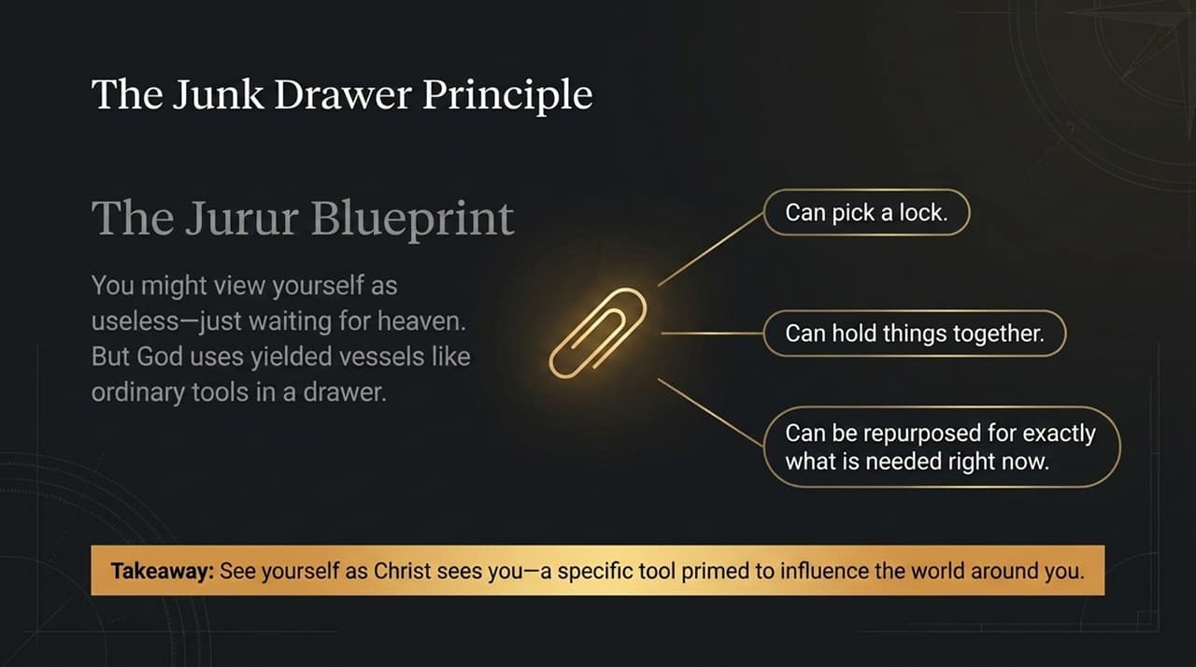
Notes:
Illustration: Most homes have a "junk drawer" in the kitchen or garage. It's filled with miscellaneous odds and ends, yet when something breaks, that drawer is the first place you go to find a solution.
Core Truth: You might look at your life and think, "I'm just an ordinary paperclip. I don't have major talents or platforms; I'm just waiting around to go to heaven."
Application: Never underestimate what God can do with a yielded vessel! A paperclip in the right hands can pick a lock, hold critical items together, or be repurposed for an immediate need. Stop sitting on the sidelines twiddling your thumbs. View yourself as a precise tool in God’s hand, ready to influence those right in front of you.

Slide 6
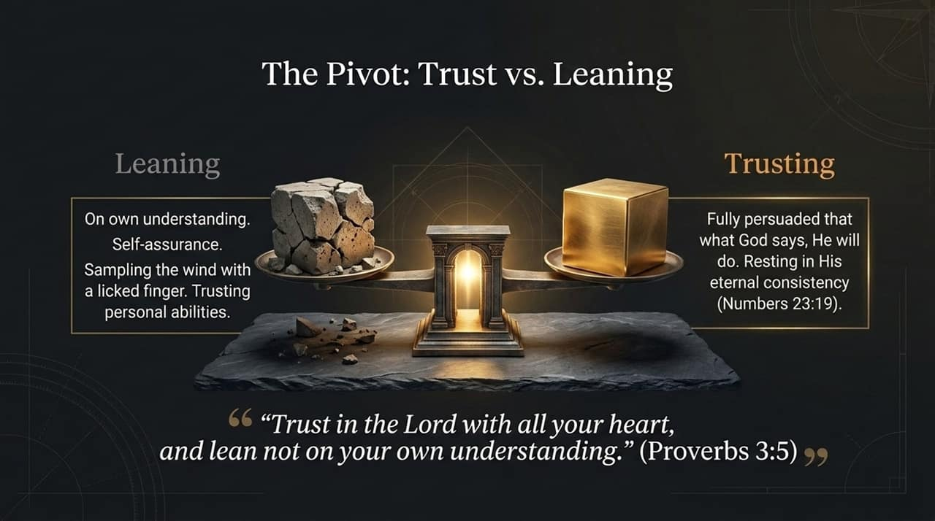
Notes:
Key Scripture: Proverbs 3:5 presents a vital spiritual pivot: "Trust in the Lord with all your heart, and lean not on your own understanding."
Deconstructing "Leaning": Leaning on your own understanding means relying on self-assurance, personal talent, or "licking your finger and holding it up to sample the wind." Human reasoning is dark and limited at best.
Defining "Trusting": Trusting means being completely persuaded that God is not a man that He should lie (Numbers 23:19). What He has spoken, He will accomplish. The pivotal choice every day is: Will you lean on your fragile intellect, or will you rest in God's unshakeable character?

Slide 7
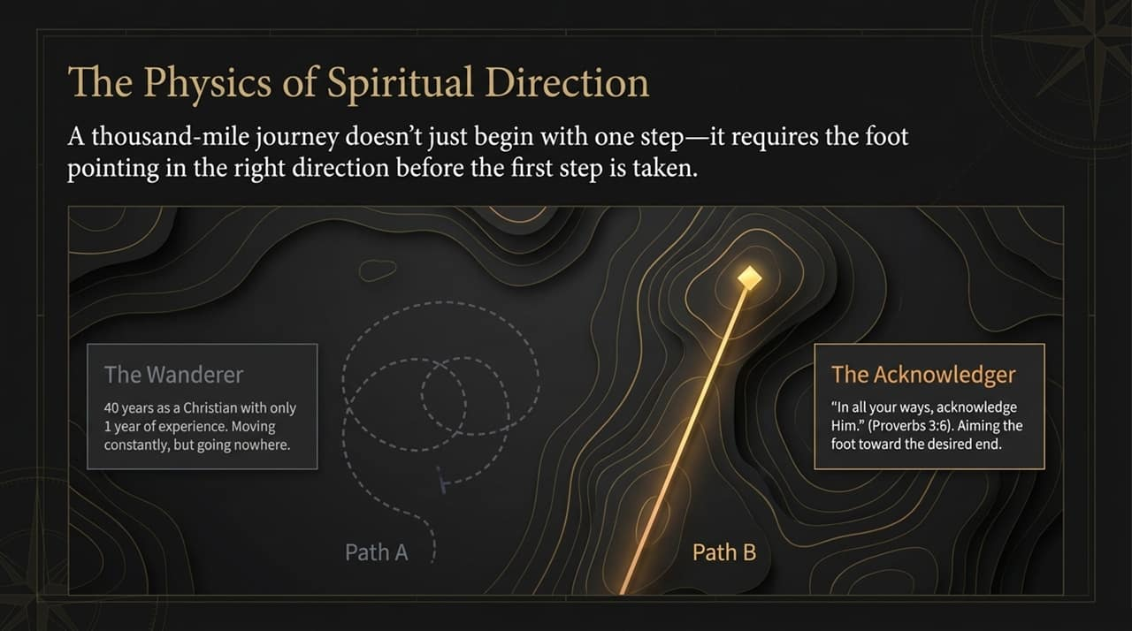
Notes:
Concept: People often quote the secular saying that "a journey of a thousand miles begins with a single step." But spiritually speaking, that’s incomplete. If your foot is pointing in the wrong direction, taking steps only leads you further off course!
Path A (The Wanderer): Many believers spend 40 years as Christians, but only have 1 year of actual spiritual progress repeating 40 times. They wander in circles because they refuse to acknowledge God's direction.
Path B (The Acknowledger): Proverbs 3:6 says, "In all your ways acknowledge Him." To "acknowledge" means to aim your foot directly toward the desired end. True spiritual alignment requires pointing your life toward God's target before taking action.

Slide 8
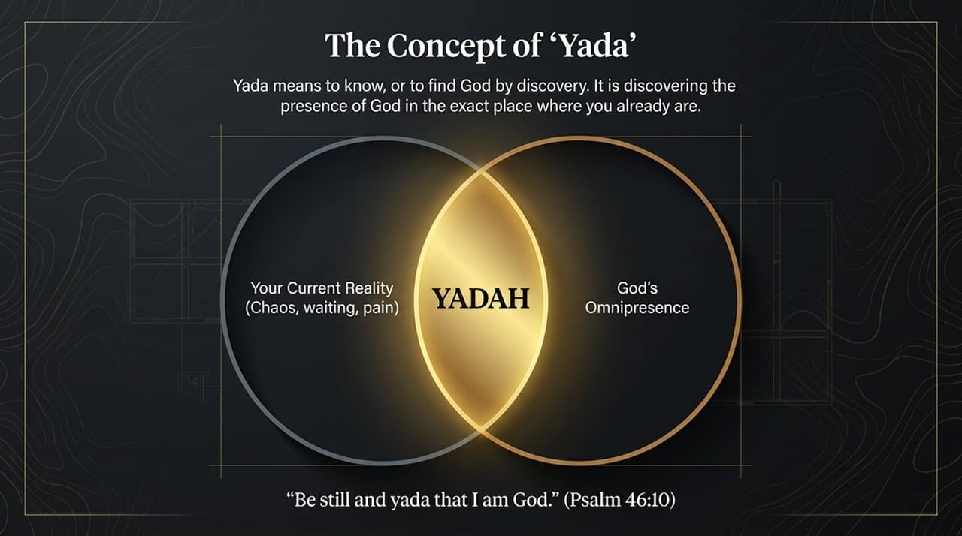
Notes:
anguage Insight: In Proverbs 3:6, the word translated as "acknowledge" comes from the rich Hebrew root Yada.
Definition: Yada goes far beyond simple head knowledge; it means "to know through personal discovery." It is discovering God’s active presence in the exact place where you are right now.
Scriptural Call: Psalm 46:10 commands: "Be still and yada [know/discover] that I am God." Whether you are in a season of waiting, chaos, or intense struggle, God is already there. You do not need to hunt Him down in a distant place—you simply need to quiet your spirit and discover Him in your current reality.

Slide 9
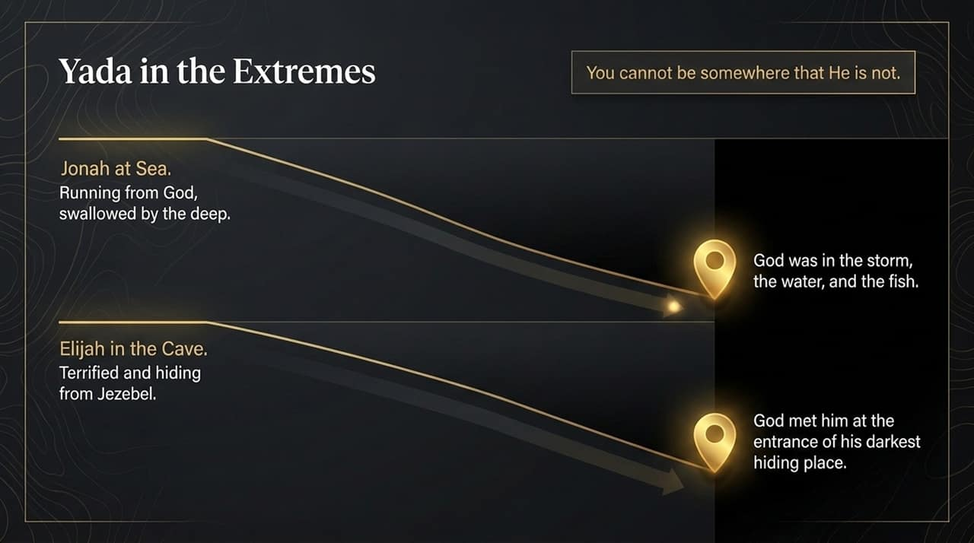
Notes:
Biblical Case Studies: Let's look at how Yada works in the absolute extremes of life:
Jonah: Jonah tried to run away from God's assignment. Yet, even when he was thrown into a raging sea and swallowed by a great fish, God was in the storm, in the water, and inside the fish. Jonah discovered God at the bottom of the ocean.
Elijah: Terrified for his life and running from Queen Jezebel, Elijah cowered in a dark cave. Yet God met Elijah right at the mouth of his dark hiding place.
Encouragement: There is no hole, no prison, no hospital room, and no heartbreak where God is absent. You cannot exist anywhere outside His omnipresence.

Slide 10
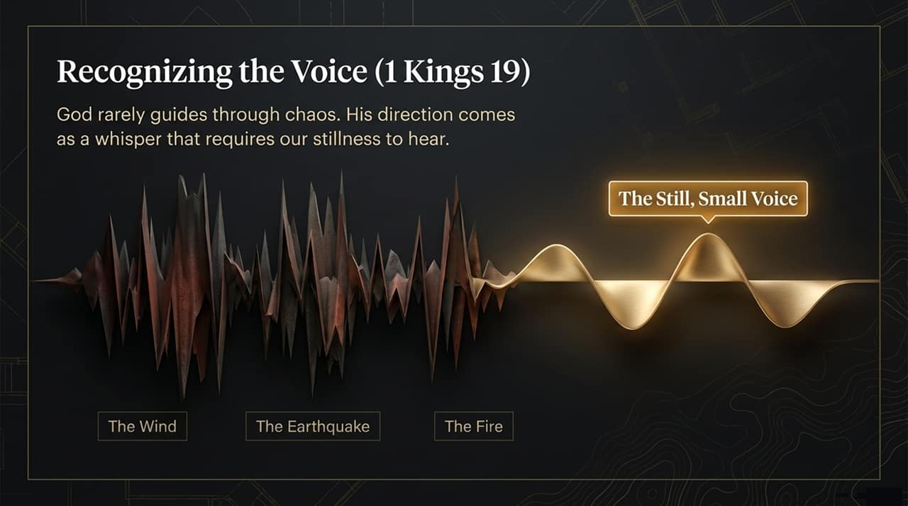
Notes:
Context: Continuing with Elijah’s story in 1 Kings 19, God gave Elijah a powerful demonstration of how He communicates.
The Noise: A mountain-shattering wind tore through, but God was not in the wind. A massive earthquake shook the ground, but God was not in the earthquake. A blazing fire swept past, but God was not in the fire.
The Whisper: After all the dramatic noise came a "still, small voice"—a quiet whisper.
Application: We live in a noisy world and often expect God to lead through dramatic events. But divine guidance usually arrives in quiet stillness. If you don't slow down, quiet your heart, and tune out the chaos, you will miss His direction.

Slide 11
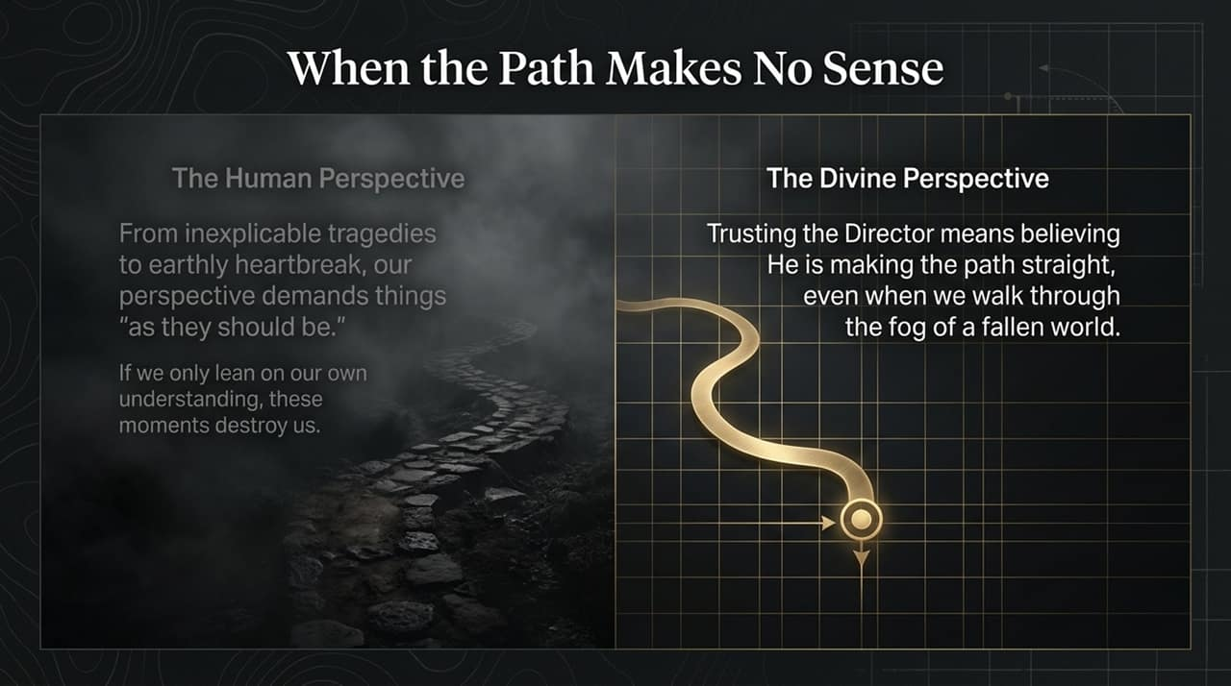
Notes:
Human Reality: In a fallen world, we encounter heart-wrenching loss, inexplicable tragedies, and sudden disappointments. Naturally, our human perspective cries out, "This isn't how things ought to be!"
The Danger of Leaning: If we try to resolve life's deepest painful mysteries strictly through human reasoning, we will crumble into bitterness or despair.
Divine Perspective: Directing your paths (Proverbs 3:6) means God makes the journey straight, smooth, and aligned with His eternal plan. Even when we cannot trace His hand or understand the surrounding fog, we can trust the Director's heart.

Slide 12
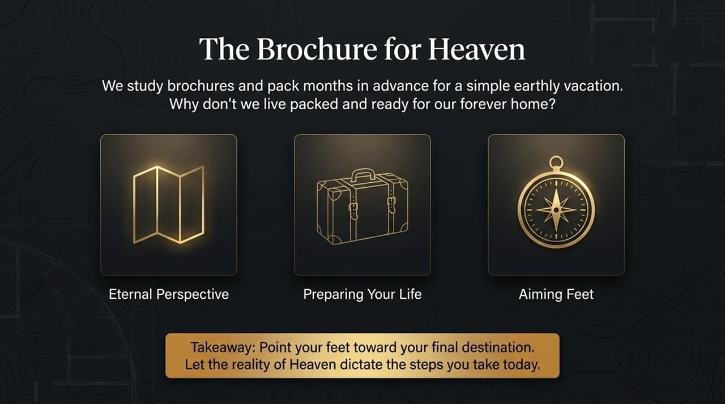
Notes:
Analogy: Think about how people plan for a week-long vacation. They request brochures, study maps, check weather reports, and pack their bags months in advance.
Challenge: If we invest so much energy preparing for a temporary trip, why do we spend so little time preparing for our eternal home in Heaven?
Action Item: As Kingdom influencers, our primary orientation must be Heaven. Pack your bags spiritually! Live every single day in light of eternity, allowing the reality of your ultimate destination to determine how you walk, serve, and speak today.

Slide 13
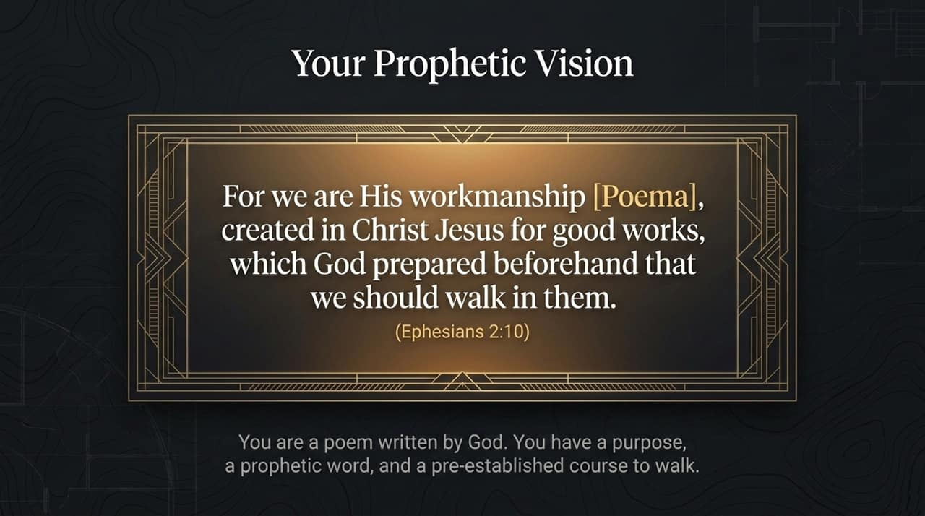
Notes:
Greek Insight: Ephesians 2:10 states that we are God's "workmanship." The Greek word used here is Poema, from which we get our word "poem."
Spiritual Identity: You are not a random mistake or an accidental collision of atoms. You are a carefully crafted masterpiece—a poem written by the Creator Himself.
Pre-Established Course: God has designed good works beforehand specifically for you to walk in. Having a "prophetic vision" for your life simply means discovering and walking in the unique assignments God crafted for you before you were ever born.

Slide 14
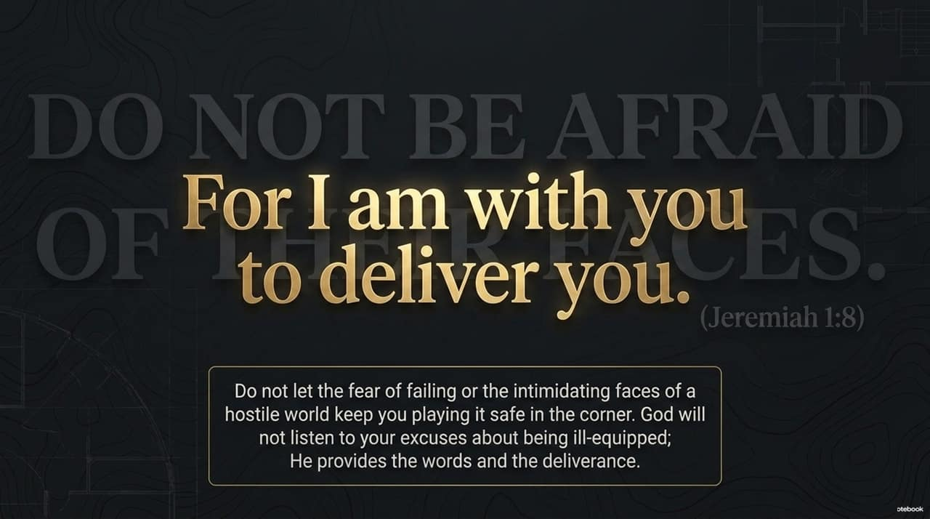
Notes:
Context: When God called the young prophet Jeremiah, Jeremiah tried to offer excuses: "I can't speak, I'm too young!" God immediately cut off his excuses.
The Command: God commanded Jeremiah in verse 8: "Do not be afraid of their faces, for I am with you to deliver you."
Personal & Practical Application: Fear of human disapproval, fear of failure, or intimidated reactions from a hostile world keep countless Christians hiding in the corner. God knows your weaknesses, but He doesn't take excuses. When He sends you, He touches your mouth, gives you His words, and guarantees His presence to deliver you.

Slide 15
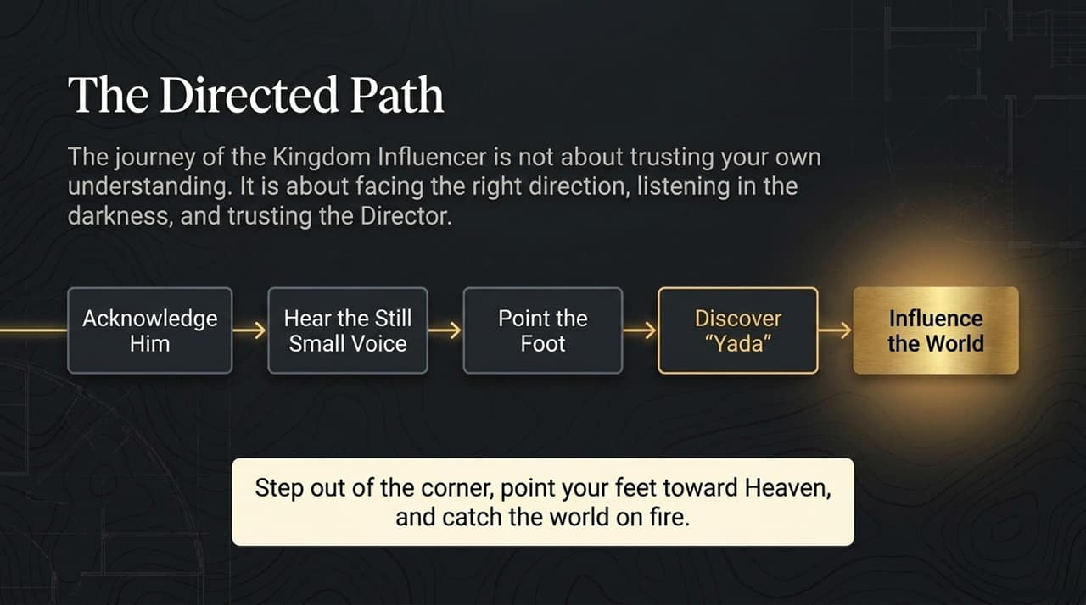
Notes:
Summary Flow: Let's synthesize the directed path into five actionable steps:
Acknowledge Him: Stop leaning on self-reliance and consult Him in everything.
Hear the Still, Small Voice: Practice inner quietness to discern His gentle whisper.
Point the Foot: Aim your life directly toward His righteousness and eternity before taking a step.
Discover "Yada": Encounter God's living presence right in your current circumstances.
Influence the World: Step out as a yield-vessel Martyr for Christ.
Call to Action: Step out of the comfortable corners of fear and passivity. Point your feet toward Heaven and set your world on fire for Jesus Christ!

Slide 16
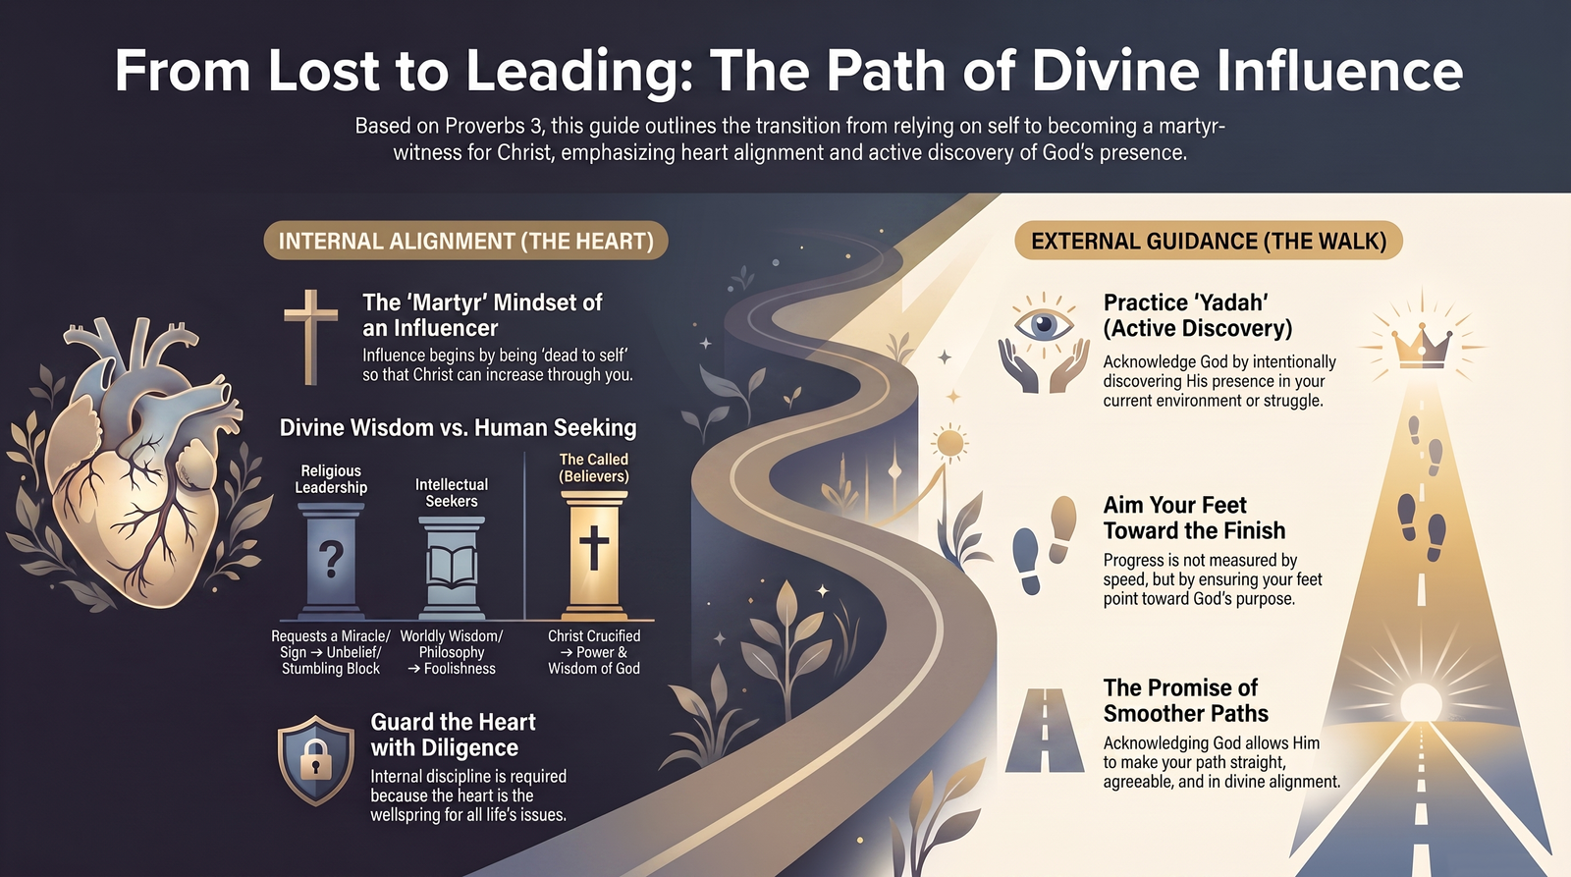
Notes:
Overview: This final synthesis slide brings the entire journey together, dividing divine influence into two core dimensions:
Internal Alignment (The Heart):
Martyr Mindset: Dying to self so Christ can increase through you.
Divine Wisdom vs. Human Seeking: Rejecting sign-seeking and worldly philosophy to rely solely on the power of Christ crucified.
Guard the Heart: Diligently protecting your heart as the wellspring of life (Proverbs 4:23).
External Guidance (The Walk):
Practice 'Yadah': Actively discovering God's presence in your daily struggles.
Aim Your Feet: Directing your daily steps toward eternal goals.
Smoother/Straight Paths: Resting in God’s promise that as you acknowledge Him, He will make your path straight and aligned with His glory.

